Slide 1

An introduction to Azure Database for PostgreSQL

Slide 2
Azure open source momentum
>60%
>60%
>47K
>100K
of VM cores are Linux
of Azure marketplace images are Linux-based
customers using Azure open source databases
Azure Data Studio instances with Azure open source database extensions
Notes:
Why should a company consider Microsoft as a top destination for migrating their open source workloads to Azure?
Today over 60% of the virtual machines run on Azure are Linux cores. We have over 47 thousand customers trusting Azure and choosing to run their open source workloads on one of our fully managed open source databases.
Customers are migrating to Azure and modernizing using AKS, Azure App Service, or the many different solutions available as businesses innovate their applications using Azure services.

Slide 3
Be future-ready with Azure and open source
A.I.
Intelligent by default
Leverage your favorite open source services on Azure with:
Seamless migration of Linux workloads
Support for modern development practices including Azure Kubernetes Service
Choice of fully managed open source database including MySQL, PostgreSQL and MariaDB
Compatibility with latest open source extensions and tools
Enjoy community-driven quality with a large developer network
Scale
Limitless
Hybrid
Operational freedom
Azure
OSS
Security
Always a step ahead
90% of enterprises deploy open source in some form*
2022 Open source security and risk analysis report, Synopsis
Notes:
Microsoft Azure is the cloud that lets you turn ideas into solutions with more than 100 services to build, deploy, and manage applications—in the cloud, on-premises, and at the edge—using the tools and frameworks of your choice. Our track record of continuous innovation supports your development today and your visions for tomorrow. Over the past year, we’ve launched over 1000 capabilities on the platform, helping our customers be future-ready. The cloud is moving fast – every week a new technology is coming out. So it’s about meeting new capabilities now and investing in those on the horizon.
In the world of data, we are committed to empowering organizations to build on their terms with flexibility and choice, and that includes the freedom to operate anywhere.
Nothing is more important than trust, particularly when you’re talking about the cloud. We spend $1B a year on cyber security with 3500 cyber security engineers who are constantly monitoring your data for threats. We’ve invested ahead of the curve in layers of security with built-in controls to protect your data and close the gaps that attackers can exploit. Trust your workloads to Azure, built upon the most secure cloud with the broadest compliance coverage.
Break through the resource constraints of modern application development with limitless scale that goes far beyond other cloud providers.
Modernize existing apps or build new apps on Azure with built-in, AI-based technologies that power new customer experiences.
Azure can help you innovate today, tomorrow, and in the future. We are constantly providing capabilities that can help meet your needs.

Slide 4
Open source = PostgreSQL = value
The most loved and wanted database in Stack Overflow’s 2022 Developer Survey
Ranked 2017, 2018 and 2020
DBMS of the Year
by DB-Engines
https://survey.stackoverflow.co/2022/#section-most-loved-dreaded-and-wanted-databases
https://db-engines.com/en/blog_post/85

Slide 5
PostgreSQL has staying power for a reason
Open source
SQL-compliant
Extensible
Developer-centric
The world’s most advanced open source relational database
https://www.postgresql.org/

Slide 6
Focus on your application, not your database
PaaS
Azure Database for PostgreSQL
IaaS
Azure VMs with PostgreSQL
On-premises
PostgreSQL
Intelligent performance/security
Applications
Applications
Applications
Data
Data
Data
High availability /DR/Backups
High availability /DR/Backups
High availability/ DR/Backups
Database provision/ Patch/Scaling
Database provision/ Patch/Scaling
Database provision/ Patch/Scaling
O/S provision /patching
O/S
O/S
Enterprise-grade managed services for PostgreSQL that consistently delivers value and performance
Virtualization
Virtualization
Virtualization
Hardware
Hardware
Hardware
Datacenter management
Datacenter management
Datacenter management
Machine learning capability
Managed by customer
Managed by Microsoft
Notes:
Here at Microsoft, it’s incredibly important for us to meet customers and developers where they are and support their applications requirements. So depending on your workload, Azure offers the option to move your database and lift and shift it to a VM to get the benefits of being on Azure and an IaaS environment, OR ALTERNATIVELY you can leverage the features and functionality that come with our PaaS services.
By moving to a PaaS service you can expect
greater manageability and security
improved performance with intelligent features and global SCALE
and the benefits of built-in tools and resources.

Slide 7
Azure builds upon the core benefits of PostgreSQL
Security
Intelligent performance
Global reach
Modern transactional apps
Compliance
Time series data
Geospatial apps
Extension support
Easy to scale
Azure Database for PostgreSQL is fully-managed, intelligent, and scalable PostgreSQL
Easy ecosystem integration
Built-in HA

Slide 8

The benefits of Azure Database for PostgreSQL
Build or migrate your workloads with confidence and optimize for value
Highly available and flexible managed database
Migrate to fully managed open source PostgreSQL
Optimize value with a lower total cost of ownership
Simplified developer experience
Advanced data security and compliance
Focus on application innovation with a fully managed, highly available PostgreSQL database, that provides maximum flexibility including zone redundant high availability, custom maintenance windows and AI powered performance optimization
Migrate with ease using a fully managed PostgreSQL databases with support for latest versions. Build with your favorite PostgreSQL extensions and Microsoft’s open-source resources including PostgreSQL extension for Azure Data Studio.
Save up to 62%¹ on a lower total cost of ownership when migrating and modernizing to Azure. Leverage stop/start features, burstable, and reserved instances and only pay for storage when your database is stopped.
Increase productivity with simplified end to end deployment experience. Utilize tight integration with PostgreSQL extensions. Reduce time to market with integration with Azure Kubernetes Service, Azure App Service and more.
Protect your data with enterprise-grade security and compliance, and enhanced security capabilities of Azure Defender and double encryption.
Notes:
¹https://azure.microsoft.com/en-us/resources/analyzing-the-economic-benefit-of-migrating-from-on-premises-instances-to-azure-database-for-postgresql/

Slide 9


Azure Database for PostgreSQL | Top Use Cases
Migration
Cloud-Native Applications
Homogeneous Migration
Oracle to Postgres Migration
Transactional applications
Geospatial aware applications
SaaS
applications
Seamless migration experience leveraging high performance and secure Azure Database for PostgreSQL
Complete migrations faster and realize significant cost savings
Engage cloud native developers with the flexibility of AKS and extensibility of PostgreSQL
Leverage PostGIS, the world’s most popular OS geospatial solution to deliver location-aware experiences
Enjoy high-throughput and cloud scalability during peak times for multi-tenant SaaS applications

Slide 10


Azure relational open-source databases
PaaS and hybrid databases
Azure Database for PostgreSQL
Azure Cosmos DB for PostgreSQL
Platform-as-a-Service
Flexible Server
Distributed Postgres
Best for migrating, modernizing, and building PostgreSQL apps with the broadest Postgres extension support
Best for building cloud-native & digital apps with a fast PostgreSQL database for any scale
Azure Arc-enabled PostgreSQL (preview)
Hybrid
Best for hybrid data workloads operating on any infrastructure with or without a direct connection to the cloud
Notes:
Azure offers both PaaS and hybrid PostgreSQL databases.
Azure Database for PostgreSQL Flexible Server is a fully-managed PostgreSQL database service with zone redundant-HA, maximum control and a simplified developer experience. Flexible server is best for migrating, modernizing, and building PostgreSQL apps with the broadest Postgres extension support.
Azure Cosmos DB for PostgreSQL is a distributed Postgres PaaS offering that is best for building cloud-native & digital apps with a fast PostgreSQL database for any scale
Azure Arc enabled PostgreSQL I is best for your hybrid data workloads that need to operate on any infrastructure with or without a direct connection to the cloud.

Slide 11
Maximum control and flexibility to meet your workload needs with Flexible Server
Maximum control for your databases
Build resilient apps across availability zones
Simplified deployment experience
Control planned downtime with custom maintenance windows
Network isolation with VNet integration and network security groups
Multiple configuration parameters for fine grained database optimization and tuning
Ensure data is always available with zone redundant high availability
Zero data loss within single and multiple availability zones
Minimize latency with co-location of app & data
Full compatibility with community edition MySQL and Postgres
Stop/Start and burstable capabilities for cost optimization
Save up to 62%² on PostgreSQL TCO when migrating to Azure
Notes:
Let’s double click on Flexible Server because it is the top deployment destination for open source databases on Azure.
Flexible Server gives users more control over their databases than running on premises or in VM’s with features such as user-controlled maintenance windows, and configuration parameters for fine grained database tuning & optimization.
Flexible Server is a resilient deployment option with zone redundant high availability to ensure business continuity and zero data loss with multiple availability zones. Additionally, users can minimize application latency by co-locating their application and data in the same Azure region.
To top it off, Flexible Server offers cost-optimization options, such as the burstable service tier, reserved instance pricing to lock in your costs, and stop-start capabilities to ensure users are only paying for storage that they use. Additionally, users can save on a lower total cost of ownership by up to 62% with PostgreSQL when migrating these on premises workloads to Azure.
Overall flexible server is a simplified end-to-end deployment experience offering increased productivity for your open source databases.
² Results are based on interviewed customers. “The Economic Value of Migrating and Modernizing On-premises Instances to Azure Database for PostgreSQL,” a commissioned study conducted by The Enterprise Strategy Group on behalf of Microsoft, July 2022.

Slide 12




Build innovative applications and reduce TCO with Azure Database for PostgreSQL
Modern transactional apps built with AKS
Enable real-time operational analytics apps
Modernize SaaS apps with a cloud first approach
Migrate Oracle databases to Azure and reduce TCO
Engage cloud native developers with the flexibility of AKS and extensibility of PostgreSQL
Pursue new insights with data analytics by leveraging Power BI and Azure Database for PostgreSQL
Streamline application development with AKS and modernize with Azure
Migrate, modernize, and reduce time to market
Notes:
Finxact - https://customers.microsoft.com/en-us/story/822002-finxact-banks-on-azure-for-core-financial-services
Cloud9 - https://customers.microsoft.com/en-us/story/782270-cloud9-esports-gaming-azure-power-bi
SAS - https://customers.microsoft.com/en-us/story/1431763554334987166-scandinavian-airlines-speeds-app-development-lowers-costs-azure-database-postgresql
OBB - https://customers.microsoft.com/en-us/story/1419043525370670241-obb-expands-business-improves-time-to-market-using-azure

Slide 13
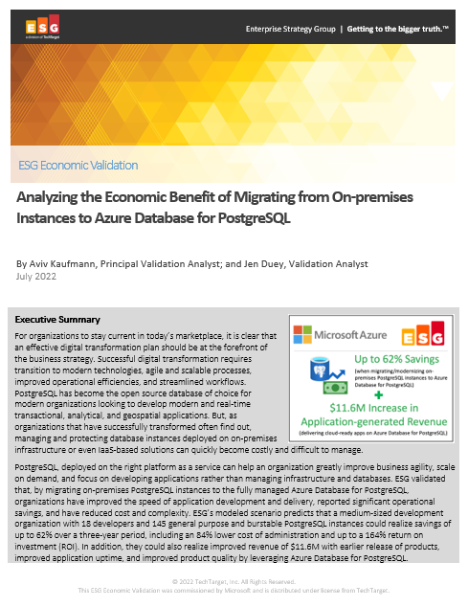
Significantly reduce cost when migrating workloads to PaaS
Key report benefits and findings¹
Up to 62%
Cost savings when migrating on-premises PostgreSQL instances to Azure Database for PostgreSQL
Microsoft commissioned Enterprise Strategy Group to conduct an Economic Value study to examine potential cost savings and business benefits enterprises would achieve from migrating on-premises workloads to Azure Database for PostgreSQL.
Modernizing on Azure Database for PostgreSQL yields even greater benefits…
+$11.6M
Additional revenue due
to faster time to market
84%
Reduction in
operational cost
164%
based on the expected savings and benefits
71%
Lower cost of systems administration
1 Results are based on interviewed customers. “Analyzing the Economic Benefit of Migrating from On-premises Instances to Azure Database for PostgreSQL,” a commissioned study conducted by The Enterprise Strategy Group on behalf of Microsoft, July 2022.
Notes:
We partnered with the Enterprise Strategy Group to validate the cost savings, operational efficiency, and improved business agility that customers reported when migrating their on-premises PostgreSQL instances to Azure Database for PostgreSQL Flexible Server and the TOP-LEVEL FINDINGS from ESG’s model FOUND THAT Azure Database for PostgreSQL provided UP TO a 62% LOWER TOTAL COST over a three-year period to deliver the services to host, secure, and protect PostgreSQL instances.
This included an enormous 84% reduction in the operational cost to deploy, manage, and maintain PostgreSQL instances on an on-premises environment. Azure Database for PostgreSQL offloads the majority of the work currently performed by developers, which reduces the EXPECTED cost to administer, tune, secure, protect, and maintain the MySQL databases by UP TO 71%.
These savings equate to roughly 4 full-time developers’ worth of PRODUCTIVITY SAVED, which equates to a 21% increase in development capacity, resulting in $11.6M dollars in additional expected revenue for the organization.
This is a perfect example of how Azure managed open source databases can reduce your total cost of ownership when migrating your workloads to Azure.

Slide 14





Azure is the best destination for PostgreSQL
Best of open source community along with the manageability and integration benefits of Azure
Open Source
Proven resilience & stability
Rich feature set
Integrated with Azure data ecosystem
Fully managed
Intelligent Performance
Cost effective
High Availability
Maximum control
Identity, security, management, and compliance
Notes:
And last but definitely not the least, we provide integration points with Active Directory Integration, Azure Data Factory and PowerBI so that you can build your application end to end on Azure.

Slide 15

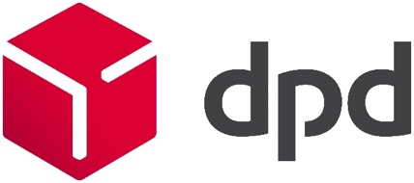




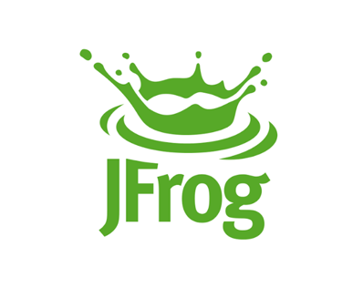

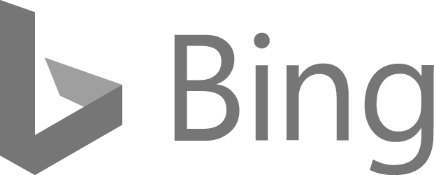






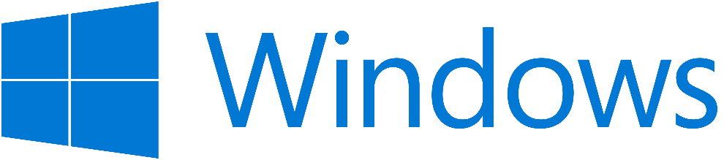

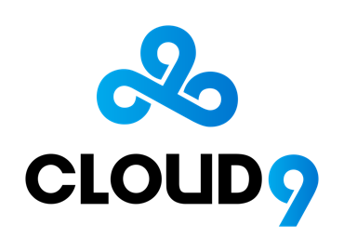





Industries and Brands
"Azure Database for PostgreSQL gives us the richness of relational SQL, open source extensibility, and the operational simplicity to run at JFrog scale. We are able to provide an End-to-End DevOps platform that customers depend on every day to handle mission-critical workloads."
Casey O'Mara, Director of Cloud Alliance at JFrog
Notes:
There are several industries & brands that are using Azure Database for PostgreSQL to power their mission critical applications.

Slide 16
Microsoft’s commitment to PostgreSQL community
Ongoing innovation, code, extensions, a big focus on scale—and sharing expertise
PostgreSQL
Citus Open Source Extension
More Postgres Extensions
Several of our engineers are Postgres committers and spend the bulk of their time working on maintenance and future releases of the PostgreSQL open source database
Our Citus extension to Postgres transforms Postgres into a distributed database. You can find the Citus open source project on GitHub—with open source docs online at citusdata.com.
We have created and maintain other popular open source extensions to Postgres such as pg_cron, pg_auto_failover, and topn. We also maintain the HyperLogLog (hll) extension used for estimating distinct counts.

Slide 17
Highly available and flexible PostgreSQL
Fully managed with automatic updates
Choice of single zone and zone-redundant data
Maximum control and customization
Highly
scalable
Focus on application innovation with automatic maintenance, patching, and updates
Ensure your data is available when you select same zone or zone redundant high availability with up to a 99.99% SLA
Control timing of maintenance with custom maintenance windows
Flexibility to make fine-grained customizations
Scale compute and storage independently based on your workload
Azure Database for PostgreSQL supports a large variety of PostgreSQL versions

Slide 18
Work smarter with intelligent performance optimization features
Intelligent performance
Performance troubleshooting
Data visualization
Customized recommendations
Improve performance and decrease cost with comprehensive database monitoring and optimization tools
Automatically track and log query performance over time
Visualize query performance data to identify how your longest running queries change over time
Azure analyzes the workloads across your server to generate customized performance recommendations

Slide 19
Open-source freedom with ecosystem of extensions
Full compatibility
Familiar extensions and languages
Microsoft open-source contributions
Committed to the community
Enjoy a fully compatible PostgreSQL with support for latest community versions
Utilize tight integration with PostgreSQL extensions such as as PG Cron, PostGIS, and PLV8
Use popular frameworks and languages like Ruby on Rails, Python with Django, Java with Spring Boot, and Node.js
Take advantage of contributions including Citus Community on GitHub and the PostgreSQL extension (preview) for Azure Data Studio
Stay at the forefront of PostgreSQL innovation with the community making significant code contributions to future versions of PostgreSQL

Slide 20
Simplified Developer Experience
Boost productivity
Smart
integrations
Easy and cost effective to get started
Increase productivity with guided developer experience that simplifies end to end deployment
Reduce time to market with tight integration to Azure Kubernetes Service, Azure App Service and more
Option to get started for free with Azure free accounts. Leverage burstable or reserved instance pricing and start/stop capabilities to optimize cost

Slide 21


Advanced data security and compliance
Azure Defender
Virtual
networks
Data
encryption
Built-in compliance
Discover, track, and remediate potential threats while they occur, with Azure Defender*
Control data isolation by configuring a virtual network
Data is automatically encrypted at rest and in motion. Perform double encryption with custom keys and Transport Security Layer (TLS) 1.2 enforcement
Get industry-leading compliance, such as HIPAA, PCI DSS, FedRAMP, and ISO, built-in*
Notes:
= Single Server ONLY
Compliance certifications still underway for Flexible Server. These compliance certifications are available with Single Server

Slide 22
Optimize costs and lower total cost of ownership
Flexible pricing options
Reserved Capacity
Stop/Start functionality
Burstable compute SKUs
Scale compute, memory, and storage independently and pay only for what you use. Includes automatic database patching, query optimization, and security all at no extra cost.
Choice of 1-year or 3-year Reserved Capacity pricing and save up to 60 percent compared to the regular pay-as-you-go payment options.
Stop the PostgreSQL server when it's not needed for up to 7 days. When the database is stopped, only pay for storage*
Utilize Burstable CPU credits for workloads that need extra performance during peak times*
No upfront cost. No termination fees. Pay only for what you use.
Notes:
* Only available with Flexible Server

Slide 23
Azure helps you build better PostgreSQL apps
Fully managed and secure
Azure Database for PostgreSQL provides a fully managed community edition of PostgreSQL with built-in performance optimization and multilayered security
Azure Database for PostgreSQL Flexible Server:
Flexible Server use cases
Application developments requiring more control and customizations
Mission Critical apps utilizing zone redundancy and fine-grained maintenance scheduling
Applications requiring variable compute capacity to optimize costs
Transactional and operational analytics workloads
Apps requiring JSON, geospatial support or full-text search
Cloud-native apps built with modern frameworks
Intelligent performance optimization
Flexible and open
Optimize value with a lower total cost of ownership

Slide 24
Reserved Capacity is Now Available!
Check out the links below to learn more:
Reserved Capacity Pricing
Reserved Capacity Pricing documentation

Slide 25

Resources for migration
Microsoft Azure
Database Migration Guide http://aka.ms/datamigration
Azure Database Migration Service Migrate with minimum downtime http://aka.ms/get-dms
Sign up for Preview http://aka.ms/dms-preview
Azure Database Migration Service
On-premises workloads
Notes:
Migration guide
Provides prescriptive guidance on how to do migrations. Customers have access to case studies of migrations that other customers already did. Customers will also find a list of partners that they can contact to get assistance to do migrations.
DMS
As organizations look to optimize their IT infrastructure to have more time and resources to focus on business transformation, Microsoft is committed to accelerating these initiatives. The new Azure Database Migration Service (DMS) is a fully managed, first party Azure service that enables seamless and frictionless migrations from heterogeneous database sources to Azure Database platforms with minimal downtime. This service will streamline the tasks required to move existing competitive and SQL Server databases to Azure.
Seamlessly migrate on-premise databases at scale
Experience near zero downtime for mission critical applications
Trust in a robust, resilient service for every migration scenario
Migrate multiple database sources to Azure
Migrate with minimum migrations
Uploading a large amount of data to the cloud takes some time. Customers cannot always tolerate to stop the application while the database is being migrated. Both DMS and Attunity Replicate For Microsoft Migrations allow customers to migrate with minimum application downtime. The way it works is: while the migration is happening, the data - that users change when using the application- is replicated to the target. The mount of application downtime that customers take is reduced to the time it takes them to points the application to the target (change the connection string, change the definition of the DMS alias…).

Slide 26
General resources to learn more
Azure service page: http://aka.ms/postgresql
Documentation: Azure Database for PostgreSQL
Discussion forum: MSDN, StackOverflow
Feedback forum: User Voice
Hands-on Lab: http://aka.ms/postgresqlhol
GitHub repo: https://github.com/Azure/azure-postgresql

Slide 27
Questions? Contact @Azure Database for MySQL, PostgreSQL & MariaDB

Slide 28
Case studies

Slide 29

HarvestMark chooses Azure over Amazon for improved security and performance
Challenge
Grocery chains depend on HarvestMark for sophisticated quality assurance solutions. HarvestMark depended on AWS for reliable hosting. But when AWS branched into groceries, HarvestMark’s customers feared conflict of interest.
Solution
Azure Database for PostgreSQL enabled:
Seamless 2-hour migration with zero customer impact
Fully managed environment
20% decrease in cloud hosting service costs
“We took an instance of the database, copied it to Azure, then spun it up in the Azure managed PostgreSQL environment. It happened flawlessly in two hours…. The services and utilities, plus technical support, from Microsoft made all the difference.”
Todd Berg Head of Product and Customer Success

Slide 30


Swiss Re accelerates Java app modernization using Azure Spring Cloud
Challenge
A global wholesaler of reinsurance, Swiss Re is on a mission to modernize. Its Group Finance IT team was incrementally retiring legacy systems while bringing new services online and handling a backlog of requests. The team wanted a simpler, more agile cloud solution.
Solution
Azure Database for PostgreSQL enabled:
Zone-redundant high availability
Ability to scale to hundreds of nodes with ease
Enterprise-grade security and compliance
“Ultimately, we keep our end users happy by running a reliable and performant system.”
Jonathan Jones Lead Solutions Architect, Group Finance IT

Slide 31

Scandinavian Airlines speeds app development, lowers costs with Azure
Challenge
As a digital leader in an industry still recovering from the 2020 travel bans, SAS relies on Azure to lower infrastructure costs and gain agility for its development teams. One missing component of its Azure migration, however, was a high-availability replacement for PostgreSQL.
Solution
The company solved the problem with a move to Azure Database for PostgreSQL – Flexible Server and are leveraging high availability and the resilience of a managed cloud database service. Additionally, the booking app runs in Azure Kubernetes Service (AKS) and greatly simplifies app deployments and management while offloading the operational overhead to Azure.
Azure Database for PostgreSQL enabled:
Increased business agility with a move from IaaS to PaaS, freeing up the app team to focus on innovation rather than managing infrastructure.
Query optimization with Query Performance Insight.
Lower TCO and cost optimization with Flexible Server.
Notes:
SAS - https://customers.microsoft.com/en-us/story/1431763554334987166-scandinavian-airlines-speeds-app-development-lowers-costs-azure-database-postgresql

Slide 32


ÖBB expands its business and improves time to market using Azure
Challenge
OBB set the goal of creating a ticket-selling platform that could be used for all public transportation in Austria. This led the team to consider transforming their Ticketshop platform to enable growth at scale. To operate Ticketshop at this scale suggested cloud computing.
Solution
Azure Database for PostgreSQL enabled:
High availability with automatic failover on Flexible Server
Lowered operational overhead as a fully managed service
Live migration through the partner Striim
New opportunities for innovation with AKS
Simplified migration from language similarity with PL/pgSQL
Notes:
Link to customer story: Microsoft Customer Story-ÖBB expands its business and improves time to market using Azure

Slide 33


Bosch helps save lives by locating wrong-way vehicles in real time
Challenge
Bosch set out to solve the problem of wrong-way driving, but they did not know whether it was technically possible. For such a service to work commercially, it had to locate vehicles in real time with pinpoint precision.
Solution
Azure PostgreSQL, Azure Cache for Redis, and Azure Kubernetes Service delivered:
Fast, in-memory storage
High availability and low infrastructure maintenance
Managed Kubernetes service in the cloud
Repeatable, manageable clusters of containers
“We really enjoyed having Azure on our side because we could just spin up the service and route. We can deploy the service worldwide.”
Christian Jeschke Product Owner
Notes:
https://customers.microsoft.com/en-us/story/816933-bosch-automotive-azure-Germany

Slide 34


Finxact banks on Azure for improved performance at massive scale
Challenge
Most banks run their core systems on mainframes and enterprise Unix servers in their own datacenters. Maintaining these systems is costly and hard to staff with knowledgeable developers. Finxact wanted use the scale of cloud infrastructure to deliver a modular set of core services.
Solution
Azure Database for PostgreSQL delivered:
Flexible data model and a high-volume transaction database to provide excellent performance at massive scale
High availability across multiple Availability Zones
Managed environment for Azure Kubernetes Service (AKS) and Azure Database for PostgreSQL to handle core infrastructure tasks
“The availability of open-source services on Azure enabled Finxact to leverage the most advanced solutions to support our customers’ business needs at massive scale.”
Frank Sanchez CEO
Notes:
https://customers.microsoft.com/en-us/story/822002-finxact-banks-on-azure-for-core-financial-services

Slide 35


Esports players gain a competitive edge with Azure Database for PostgreSQL
Challenge
Professional esports franchise Cloud9 was looking for a new ways to use data to gain a competitive edge. Starting with its League of Legends team, Cloud9 wanted to better understand players’ and opponents’ performance in practice games and league matches.
Solution
Azure Database for PostgreSQL delivered:
Peace of mind with fully managed database
Instantaneous response times with no query delays
Ability to utilize Power BI to extract meaningful performance insights
“We can spin up resources as needed and turn them off when we’re done so we aren’t paying for idle compute resources when we don’t need to. Also, by using Azure Database for PostgreSQL, we can focus on the health and delivery of our application, rather than database management, which is taken care of through this service.”
Danny Brady Senior Data Engineer
Notes:
https://customers.microsoft.com/en-us/story/782270-cloud9-esports-gaming-azure-power-bi
Competitive esports organization Cloud9 fields 14 teams across 12 of the most popular esports. To give its teams an edge over opponents, Cloud9 has brought in data scientists and embraced the power of cloud computing with Microsoft Azure. With data tools like Microsoft Power BI, Cloud9 saves time and gives its players, coaches, and executives meaningful insights into individual and team performance. These insights help Cloud9 better the competition—simultaneously boosting its profile and the popularity of esports.

Slide 36
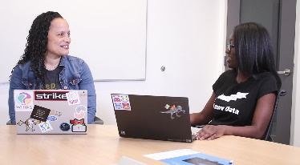
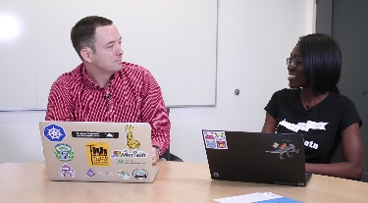
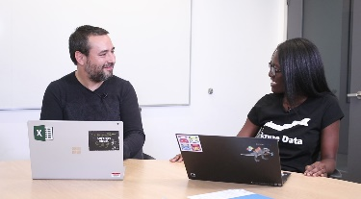

Customer use cases with snackable demo videos
Watch video
Watch video
Watch video
Watch video
Build Intelligent apps using Cognitive Services
Connect applications running in Kubernetes using the Open Service Broker for Azure
Connect your app’s data to Power BI to generate reports that provide critical insights
Migrate your PostgreSQL applications to Azure with minimal downtime

